Slide 1
Analog Anti-Aliasing Filter Group - 6

Slide 2
Group Members
Tariq Umar
Saad Bakhtiar
CMS: 334943
CMS: 341150
Muhammad
Umer
Muhammad Ahmed
Mohsin
CMS: 345834
CMS: 333060

Slide 3
Roadmap
Analog to Digital Converters
Introduction
Simulink Model
1
3
5
2
4
6
Aliasing and Sampling
Sallen-Key Topology
Results

Slide 4
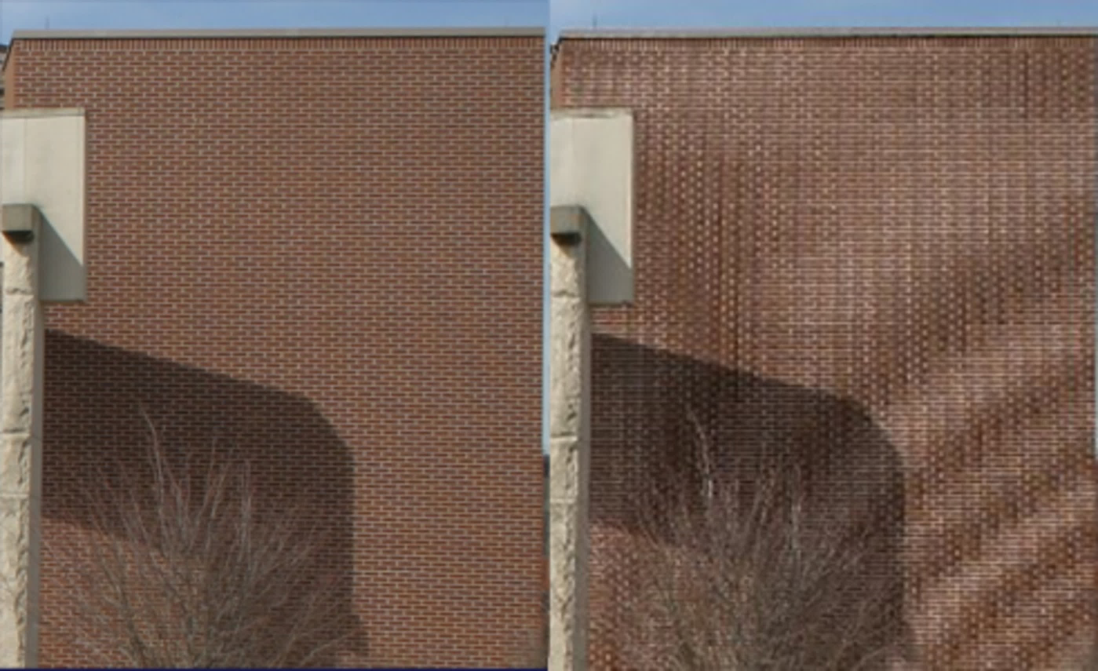
Aliasing
Aliasing is an effect that causes different signals to become indistinguishable, when they are sampled (a continuous-time signal is converted into a discrete-time signal).
It is also referred to the distortion that results when a signal, reconstructed from its samples is different from the original signal.
How do we prevent it?
Spatial Aliasing

Slide 5
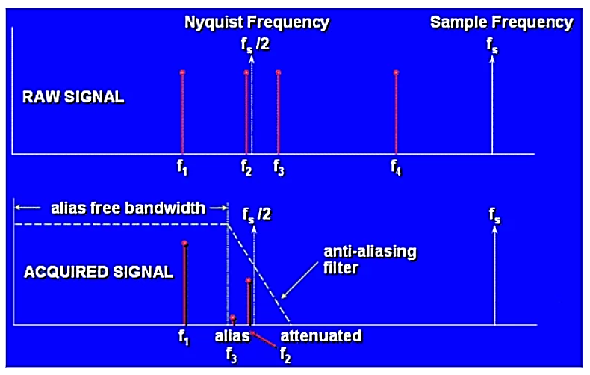
Nyquist Sampling Theorem
It states:
“That unambiguous reconstruction of the signals from the samples is possible when the power of the frequencies above the Nyquist frequency is zero. The sampling rate should be twice the maximum frequency of the signal (or band) of interest.”

Slide 6
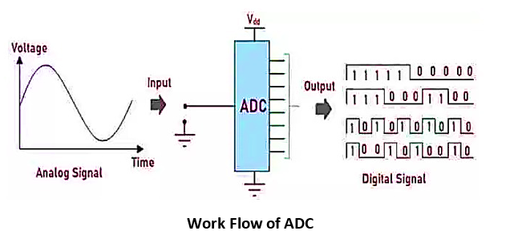
Analog-Digital Converters
Analog to Digital Converter changes the Analog signals given in an input to digital signal.
It provides isolated measurement such as an electronic device that converts an input Analog voltage or current to a digital number representing the magnitude of the voltage or current.
What factors affect the converted output?

Slide 7
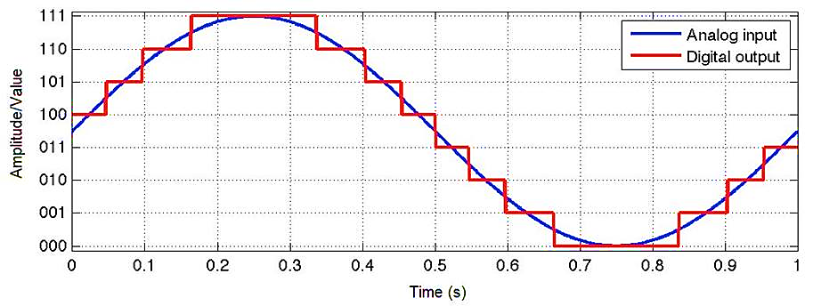
Analog-Digital Converters
Resolution of an ADC is the number of bits that represents the digital signal’s amplitude.
The Analog signal has continuous amplitude. It can have infinite values i.e. real, floating basically any value one can imagine.
On the other hand, the digital signal has a discrete and finite number of values. These discrete values are represented using binary numbers (bits).

Slide 8
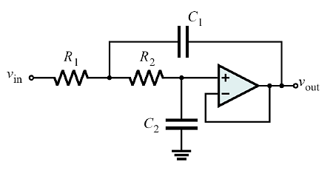
Sallen-Key Topology
The Sallen-Key Filter design is a second-order active filter topology which we can use as the basic building blocks for implementing higher order filter circuits.
It is one of the most widely used filter topologies.
The advantage of using Sallen-Key Filter designs is that they are simple to implement and understand.
Allows individual Sallen-Key filter stages to be cascaded together to produce much higher order filters.
Low-Pass Sallen Key Filter

Slide 9
Working
Low Frequency Signals
For low frequencies, the capacitor will act as an open circuit. Thus, we will simply have R1 and R2 connected in series with the input impedance of amplifier, resulting in a buffer amplifier with gain of unity.
High Frequencies Signals
For high frequencies, the capacitor will act as a short circuit. Now if C1 and C2 act has short circuit then the input to the amplifier will be 0, meaning the output will also be 0.
Middle Frequencies Signals
For middle frequencies, we will have some gain (peaking) due to the positive feedback from the output through C1. Thus, the feedback will be dependent on the value of C1. If we increase the value of C1, its impedance will decrease that will increase the feedback.

Slide 10
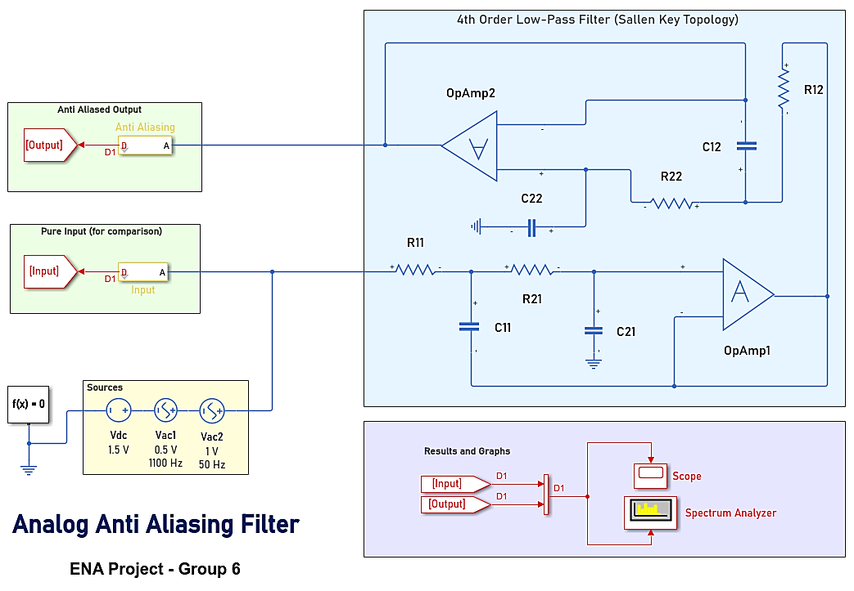
Simulink Model

Slide 11
Simulink Model: Breakdown
Analog Anti-Aliasing Filter
Spectrum Analyzer
Input
Inferences
Scope
Unfiltered Output
Breakdown and Process Flow

Slide 12
Script
% Script linked with Simulink Project
sim('aafilter') % displays the spectrum analyzer
simlog_t = simlog_aafilter.Vac2.p.v.series.time; % Get plot definitions
simlog_Vin = simlog_aafilter.Vac2.p.v.series.values('V');
simlog_Vo = simlog_aafilter.OpAmp2.out.v.series.values('V');
plot(simlog_t, simlog_Vin, 'b', 'LineWidth', 0.75) % Plot config and display
hold on
plot(simlog_t, simlog_Vo, 'r', 'LineWidth', 1.5)
hold off
grid on
title('Voltages from Anti-aliasing Filter')
ylabel('Voltage (V)’)
xlabel('Time (s)')
legend({'Source','Output'});
set(gca,'XLim',[simlog_t(end)-0.06 simlog_t(end)]); % Sets the limit for starting and ending points of X axis

Slide 13
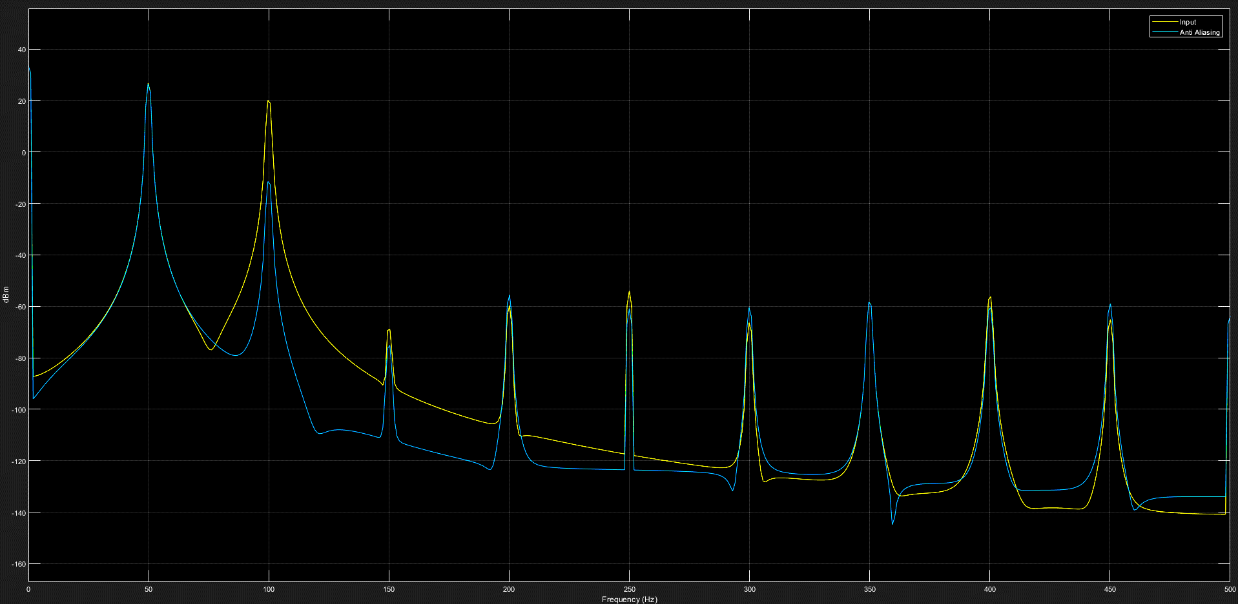

Slide 14
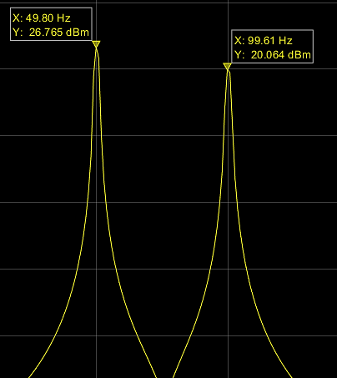
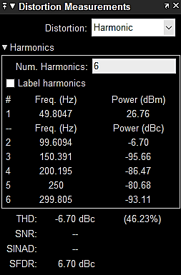
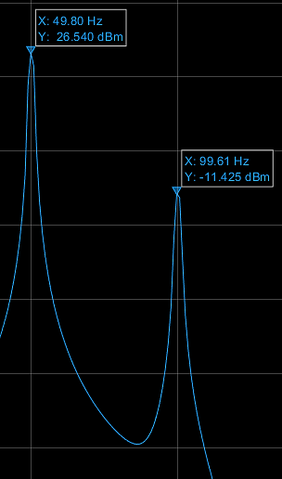
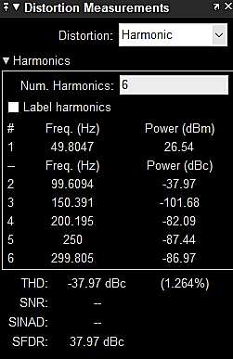
Distortion Measurements

Slide 15
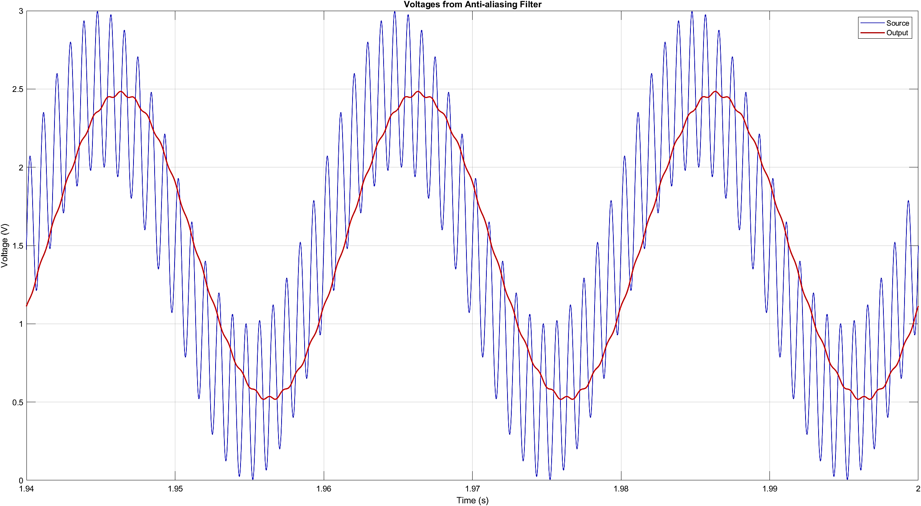

Slide 16
Thanks!
Any Questions?

